Slide 1
Lecture 3: Process Decomposition and Model Reuse

Slide 2
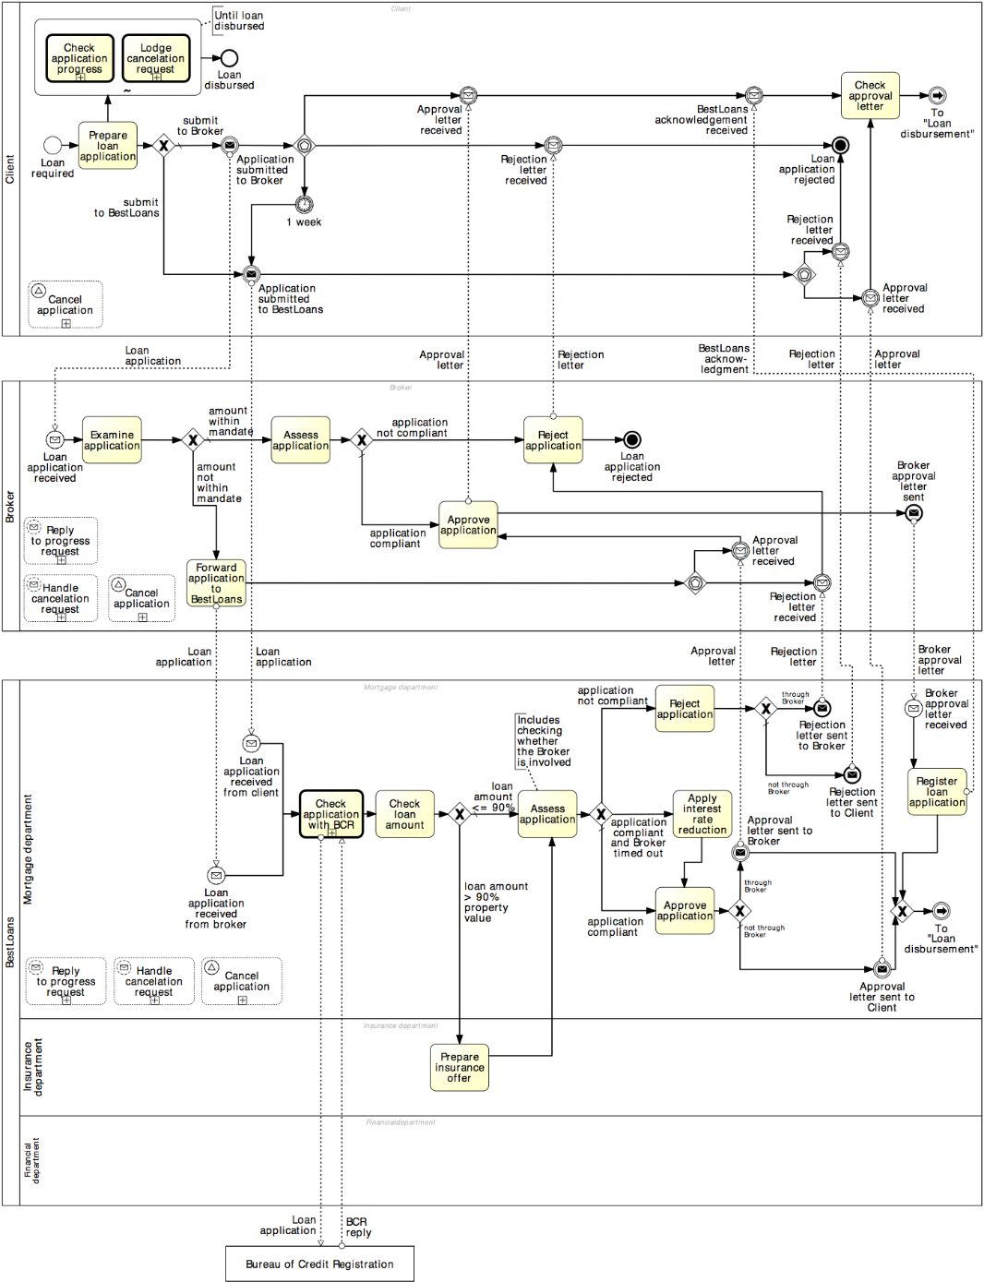
Process decomposition
Notes:
It has been shown that the larger the model, the harder it is to understand it, and the higher is the likelihood of making syntactic mistakes, e.g. creating a deadlock in the model

Slide 3
Process decomposition
An activity in a process can be decomposed into a “sub-process”
Use this feature to:
Improve understanding by breaking down large models
Identify parts that should be:
repeated
executed multiple times in parallel
interrupted, or
compensated
Activities
Notes:
For example, Emit invoice is a task, while Handle shipment is a subprocess as it includes tasks such as pick goods from warehouse shelves, package them, print shipment notice, attach it to package, load into track…

Slide 4
Example: Sub-Process

Slide 5
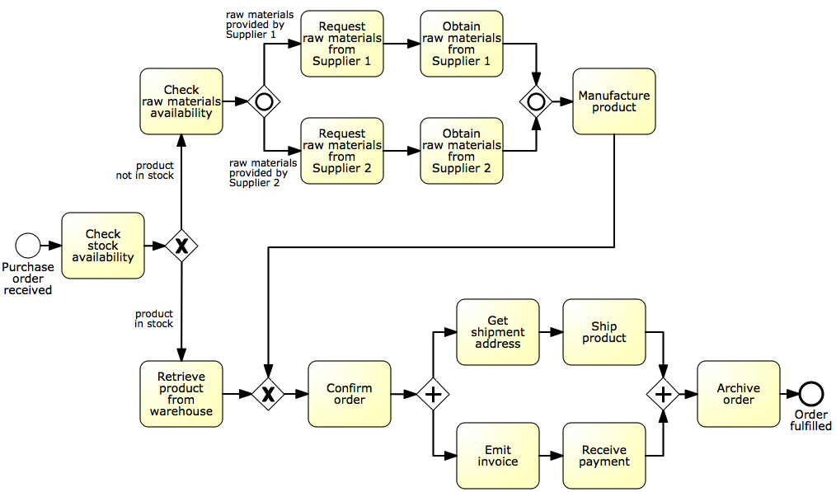
Identify possible sub-processes
Acquire raw materials
Ship and invoice
Notes:
This is a more detailed version of our order-to-cash process where we added a branch to manufacture the product in case it is not in stock, and have made the shipment and invoicing part more detailed by asking for a shipment address and receiving the payment

Slide 6
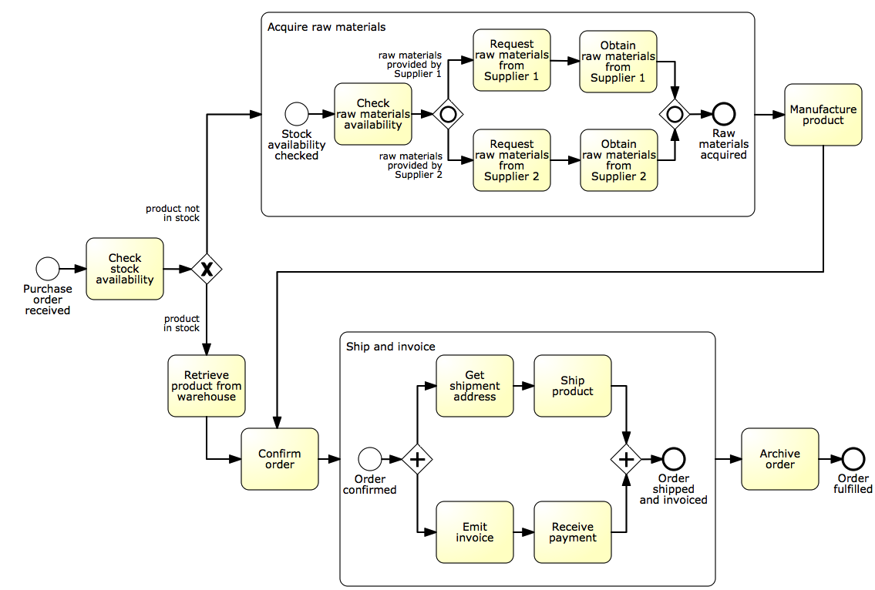
Solution

Slide 7
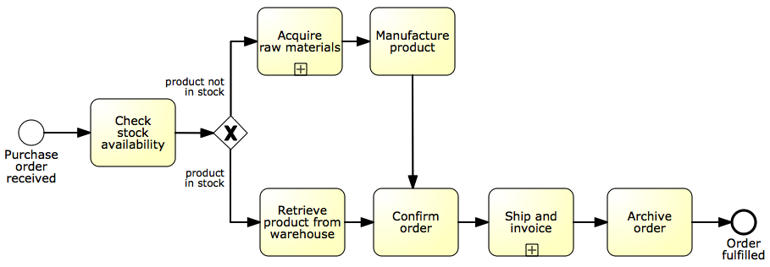
The refactored model
Notes:
From 22 to 10 nodes

Slide 8

When should we decompose a process model into sub-processes?

Slide 9
Guidelines: modeling levels
Use sub-processes when the model becomes too large:
Hard to understand
Increased error probability
Level 1 – start with value chain
Level 2 – add main decisions and handoffs (lanes)
Level 3+ – add procedural aspects:
Parallel gateways
Data objects, data stores
Exception handling
And as much detail as is relevant
Decomposition drivers:
Logical: group elements meaningfully (e.g. common business object)
Structural: up to 30 nodes (activities, events, gateways)
Notes:
Relevant: Consider domain, target audience and modelling purpose
Logical: group elements meaningfully on the basis of a common object: everything about invoice (invoice emission subprocess), everything about raw materials (acquisition from suppliers)
Structural: it has been shown empirically that having more than 30 flow objects leads to increased modelling errors

Slide 10
Embedded or global sub-processes?

Slide 11
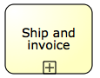
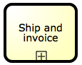
Process Reuse
By default, a sub-process is “embedded” into its parent process (i.e. it is stored within the same file)
In order to maximize reuse, it is possible to “extract” the sub-process and store it as a separate file in the process model repository
Such a sub-process is called “global” model, and is invoked via a “call” activity
(normal)
activity
Call activity
Notes:
(Call activities are represented with a thicker border)

Slide 12
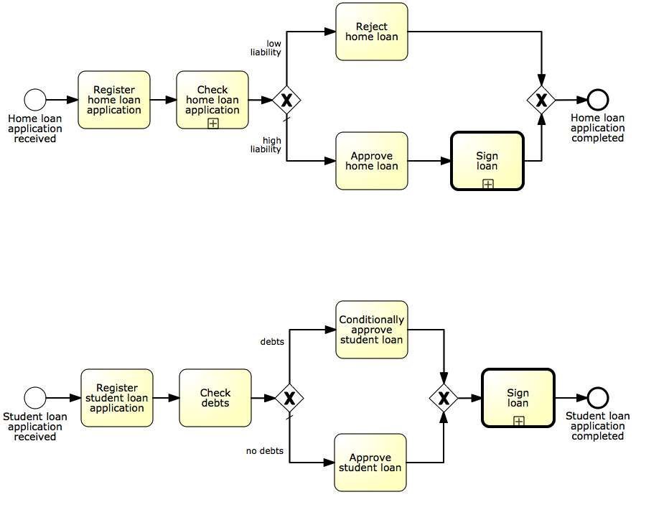
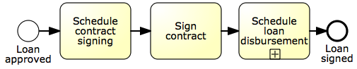
Example: process reuse
Call activity is the default choice to maximize reusability

Slide 13
BPMN so far...
BPMN activities capture units of work in a process
Events define the start and end of a process, and signal something that happens during the execution of it
Gateways model exclusive and inclusive decisions, merges, parallelism and synchronization, and repetition
A process model depicts all the possible ways a given business process can be executed, while a process instance captures one specific process execution out of all possible ones
Data objects capture a physical or digital business object required to execute an activity or trigger an event, or that results from the execution of an activity or an event occurrence
Pools generally model resource classes while lanes are used to partition pools
Sub-processes represent activities that can be broken down in a number of internal steps, as compared to tasks, which capture single units of work

Slide 14
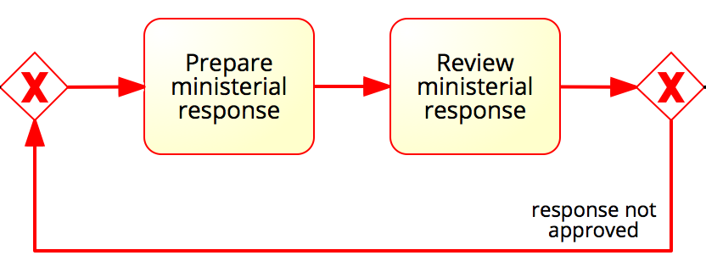
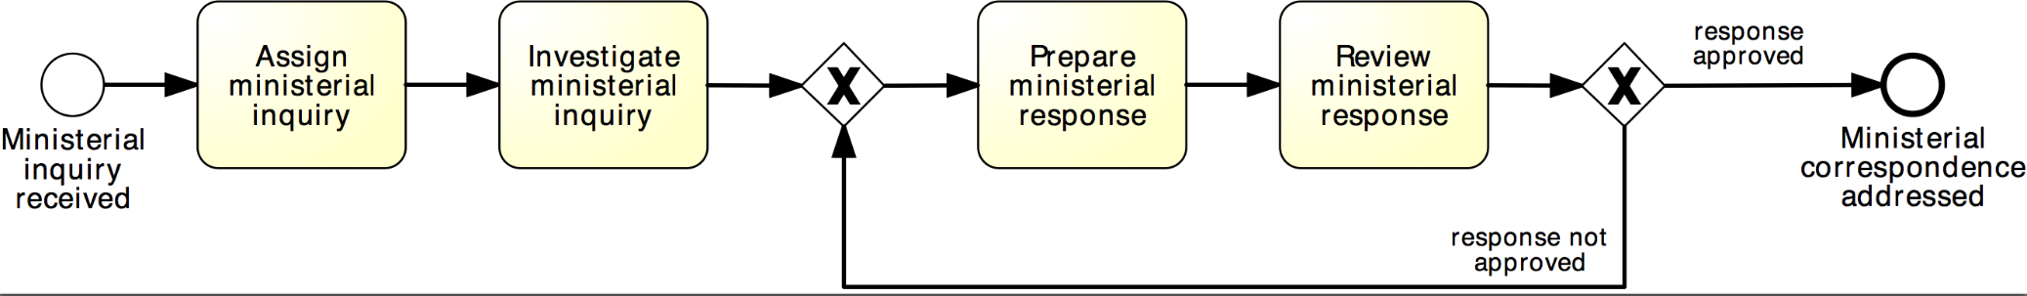
More on rework and repetition
XOR-join: entry point
XOR-split: exit point
Structured cycle (SESE fragment)
SESE = Single Entry Single Exit fragment, i.e. a fragment delimited by a single entry node and a single exit node (there are no other incoming arcs into the fragment or outgoing arcs from the fragment)

Slide 15
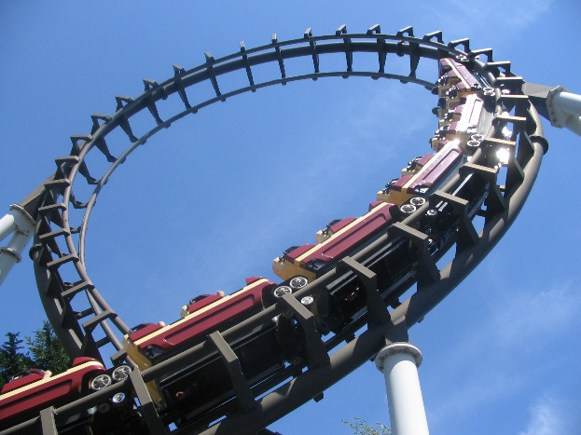
Block-structured repetition: Loop Activity
BPMN also provides the loop activity construct to allow the repetition of a task or sub-process

Slide 16
Example: block-structured repetition
Completion condition
Must have a decision activity

Slide 17
Loop Activity or (Arbitrary) Cycle?

Slide 18
Arbitrary Cycles
Arbitrary = unstructured, i.e. it can have multiple entry and exit nodes (non-SESE).
entry point
entry point
exit point
exit point

Slide 19
Example: multi-instance activity
Procurement
In procurement, typically a quote is to be obtained from all preferred suppliers (assumption: five preferred suppliers exist). After all quotes are received, they are evaluated and the best quote is selected. A corresponding purchase order is then placed.

Slide 20
Solution: without multi-instance activity
Procurement

Slide 21
Parallel repetition: multi-instance activity
Provides a mechanism to indicate that an activity is executed multiple times concurrently
Useful when the same activity needs to be executed for multiple entities or data items, such as:
Request quotes from multiple suppliers
Check the availability for each line item in an order separately
Send and gather questionnaires from multiple witnesses in the context of an insurance claim

Slide 22
Solution: with multi-instance activity
Procurement
cardinality

Slide 23
Further example: multi-instance activity
Motor insurance claim lodgement
After a car accident, a statement is sought from the witnesses that were present, in order to lodge the insurance claim. As soon as the first two statements are received, the claim can be lodged to the insurance company without waiting for the other statements.

Slide 24
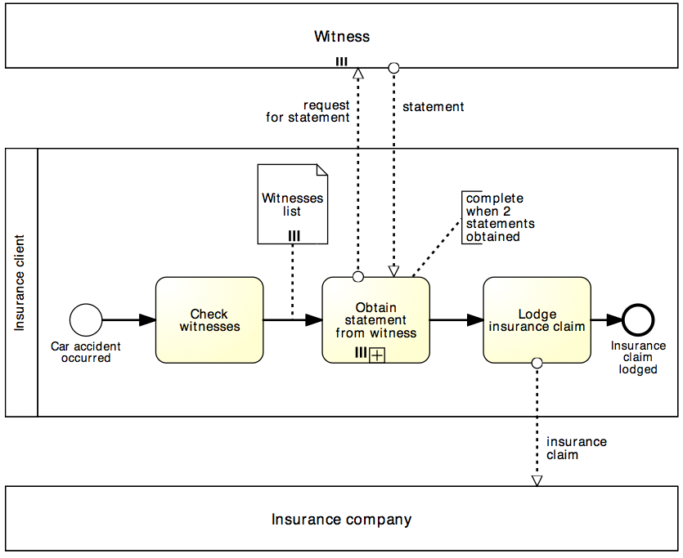
Solution: multi-instance activity
Motor insurance claim lodgement
Multi-instance pool
denotes multiple participants of the same type
Data collection denotes a set of data objects of the same type
(determines cardinality of multi-instance activity)
Completion condition indicates minimum number of instances required to complete
(≤ cardinality)

Slide 25
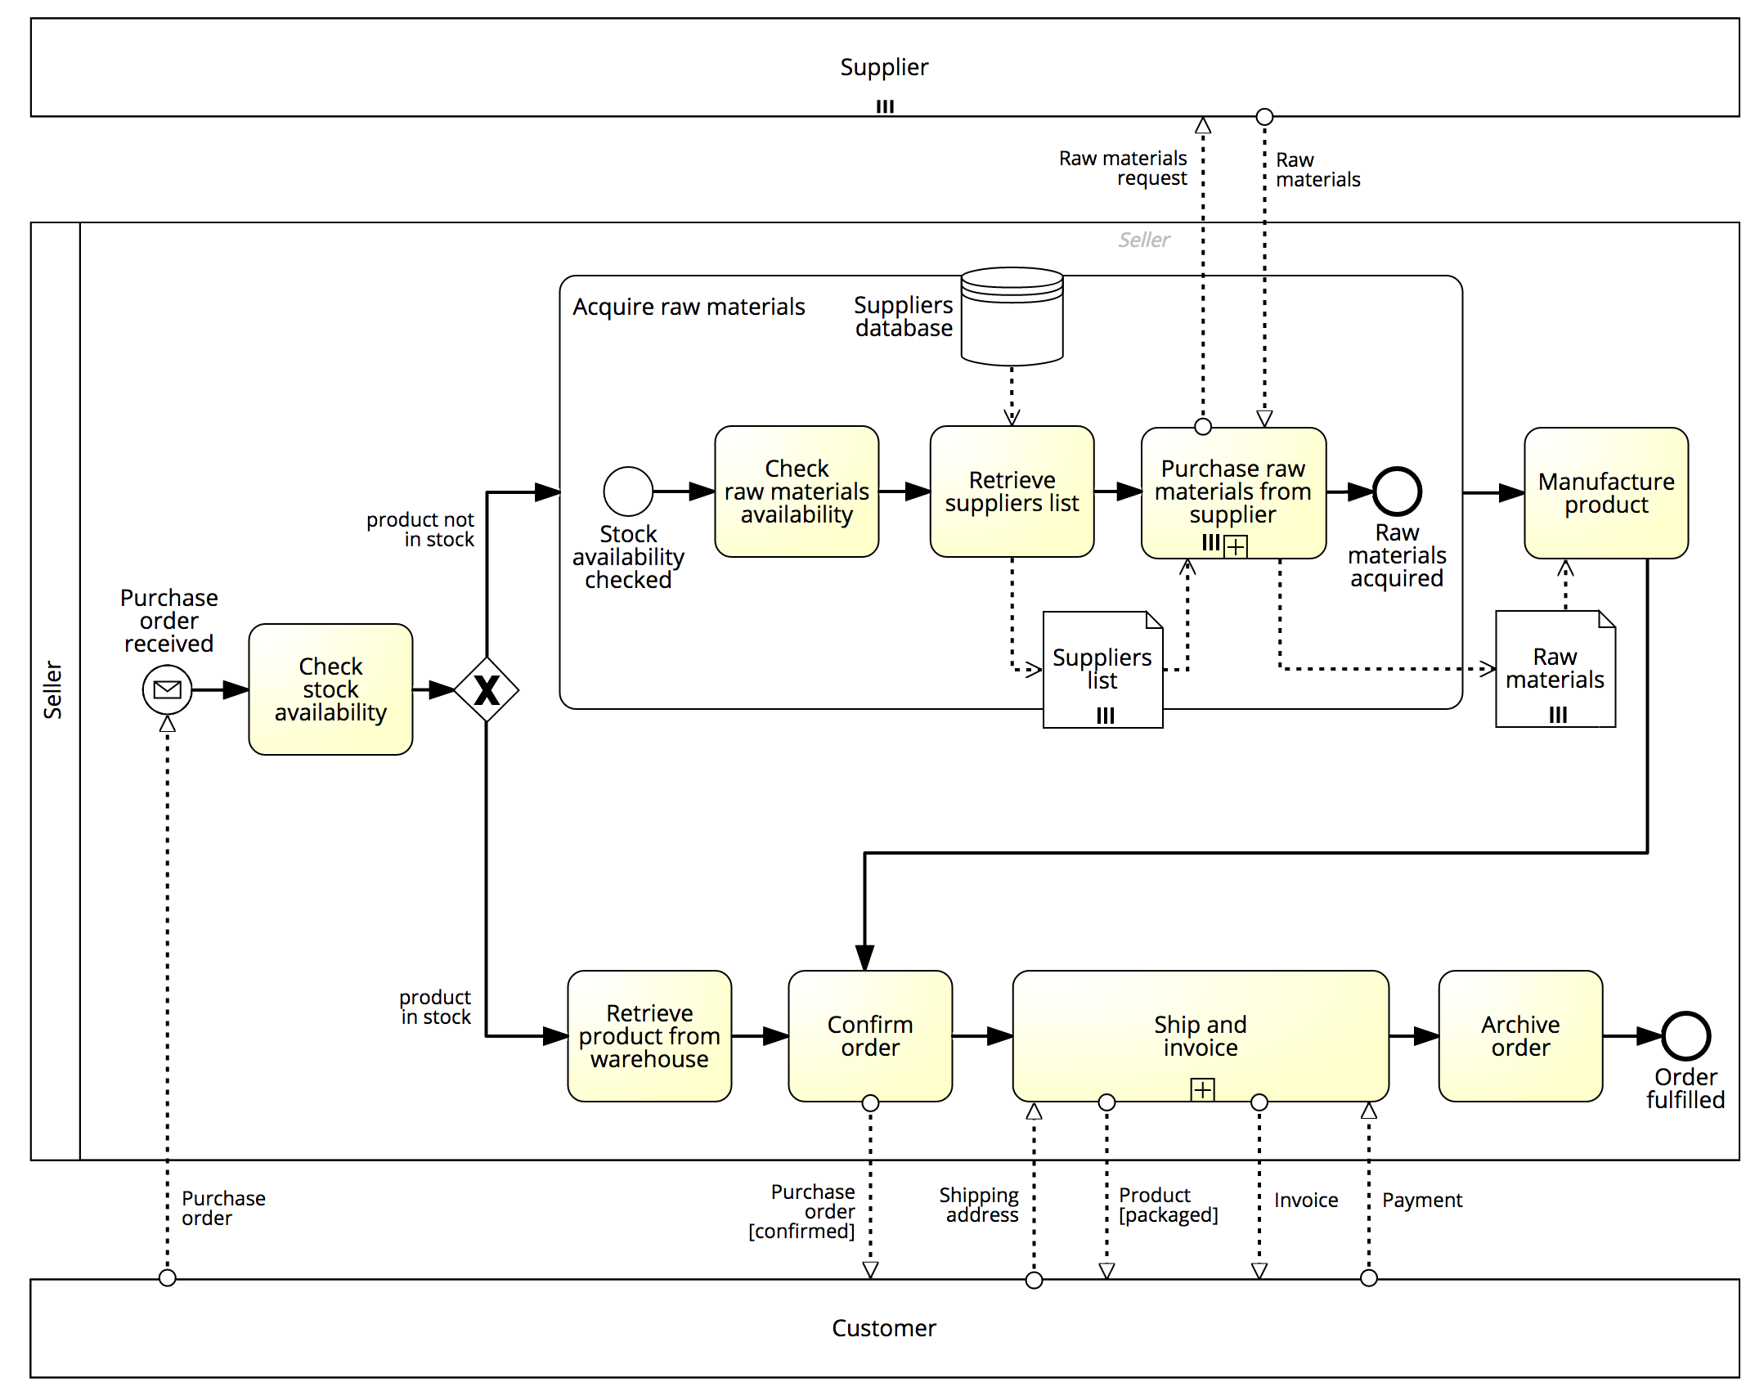
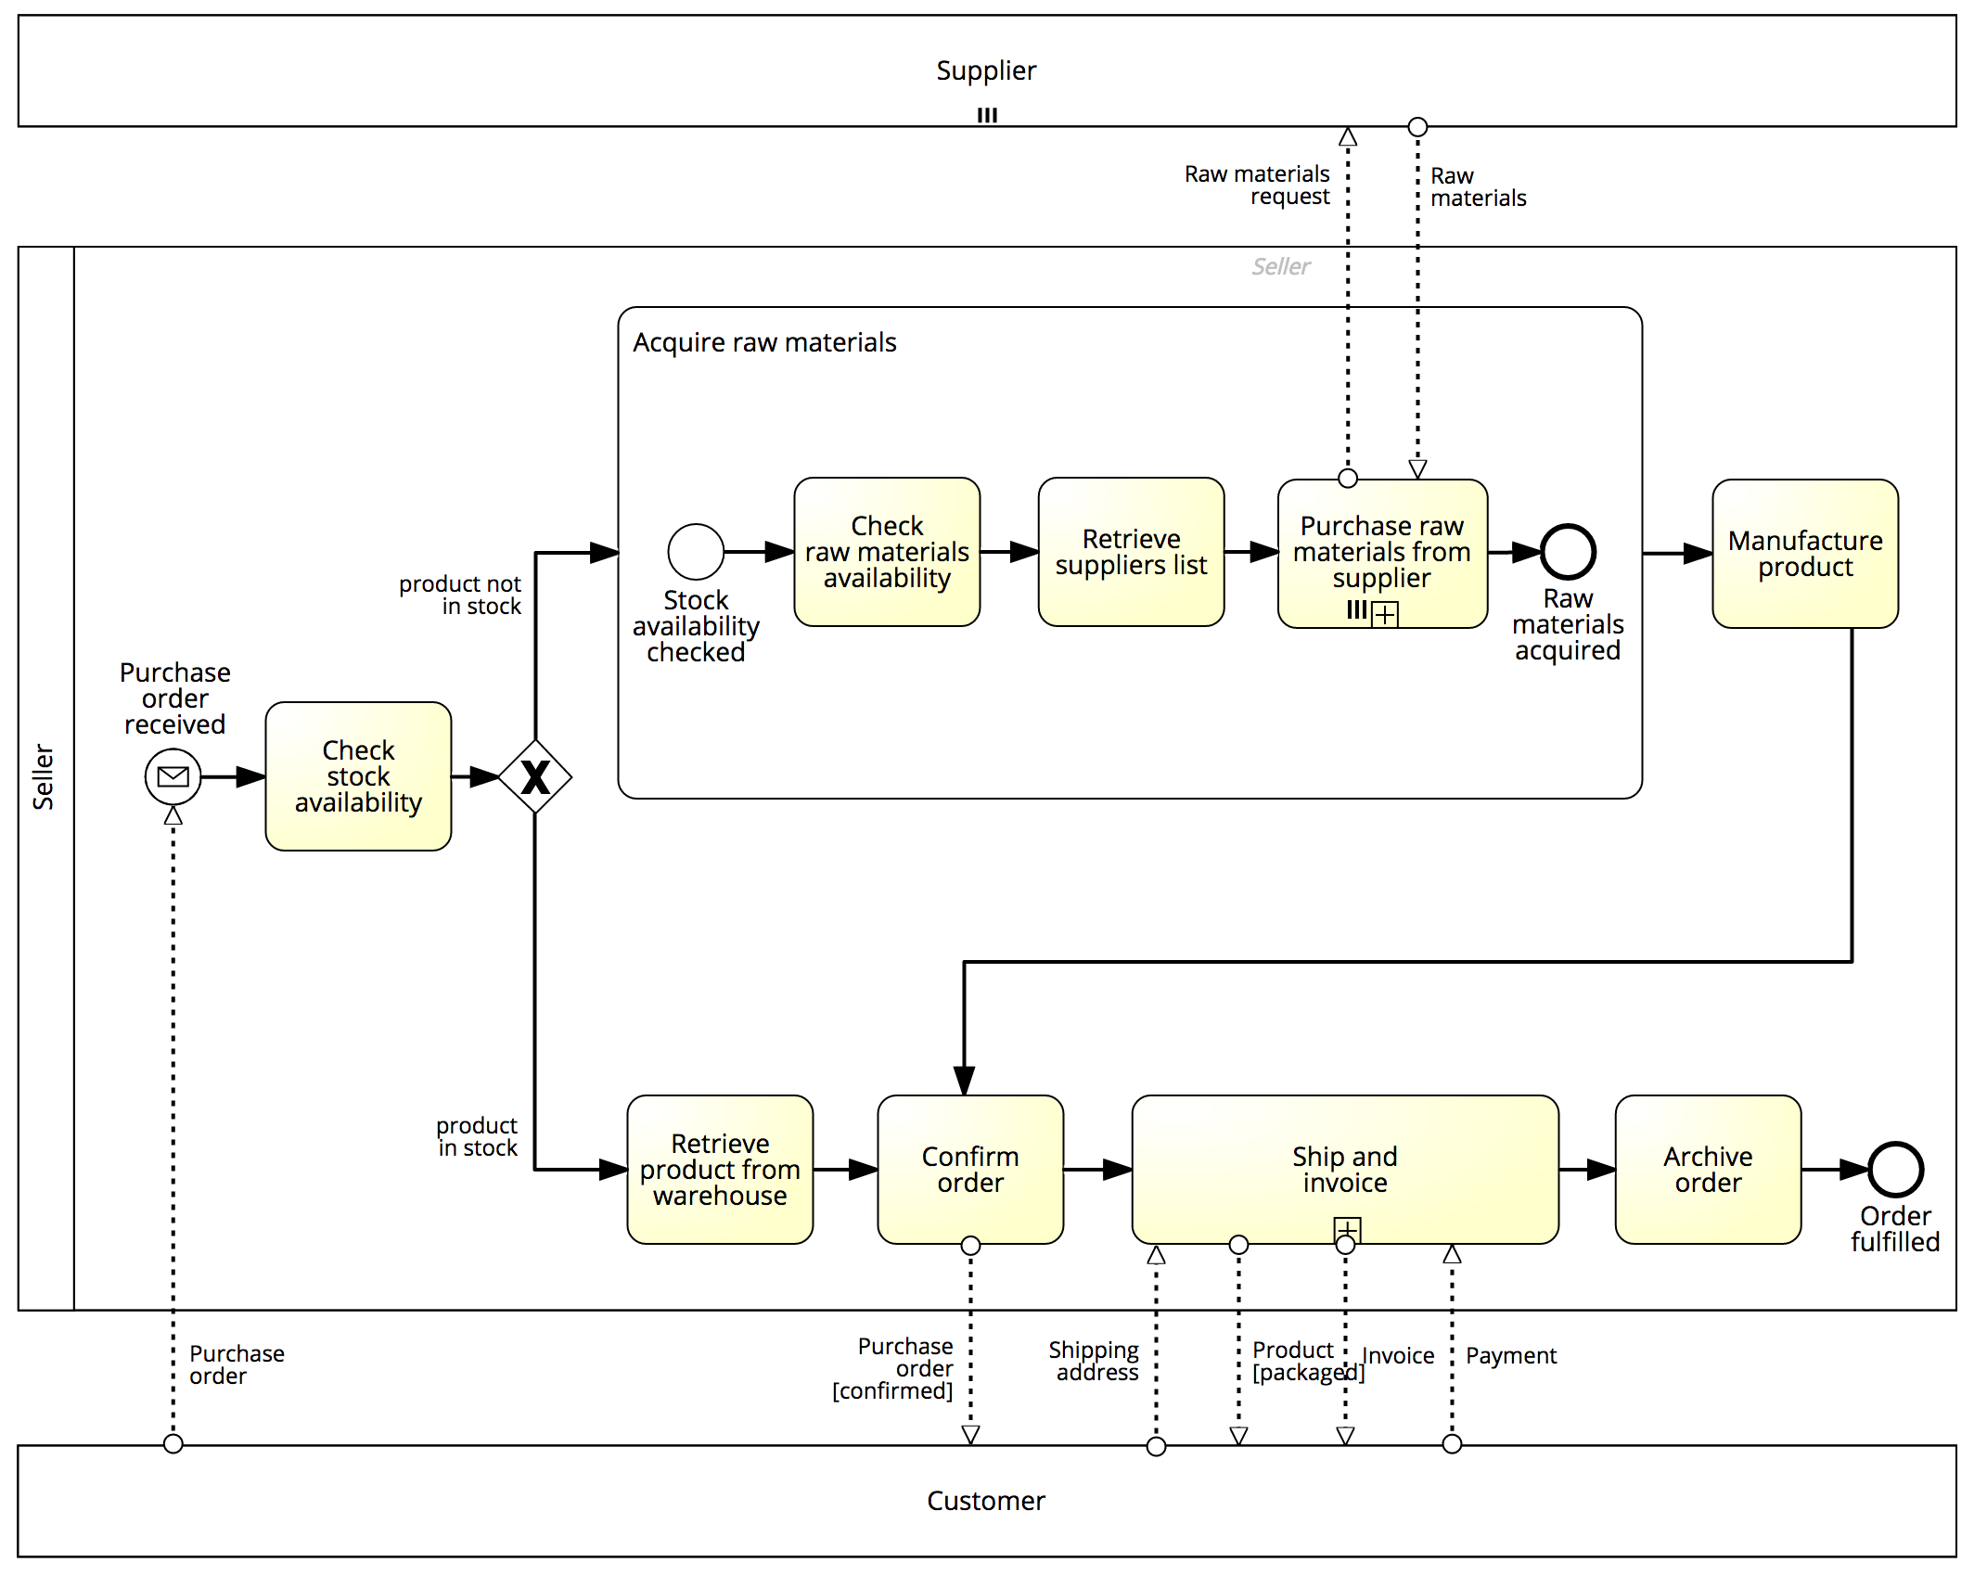
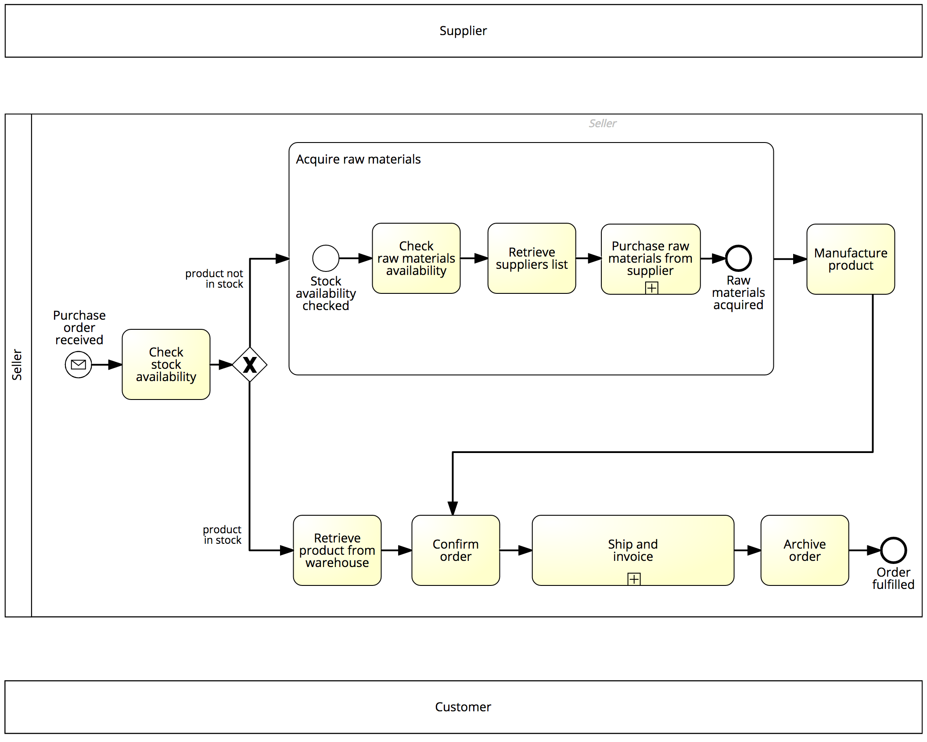
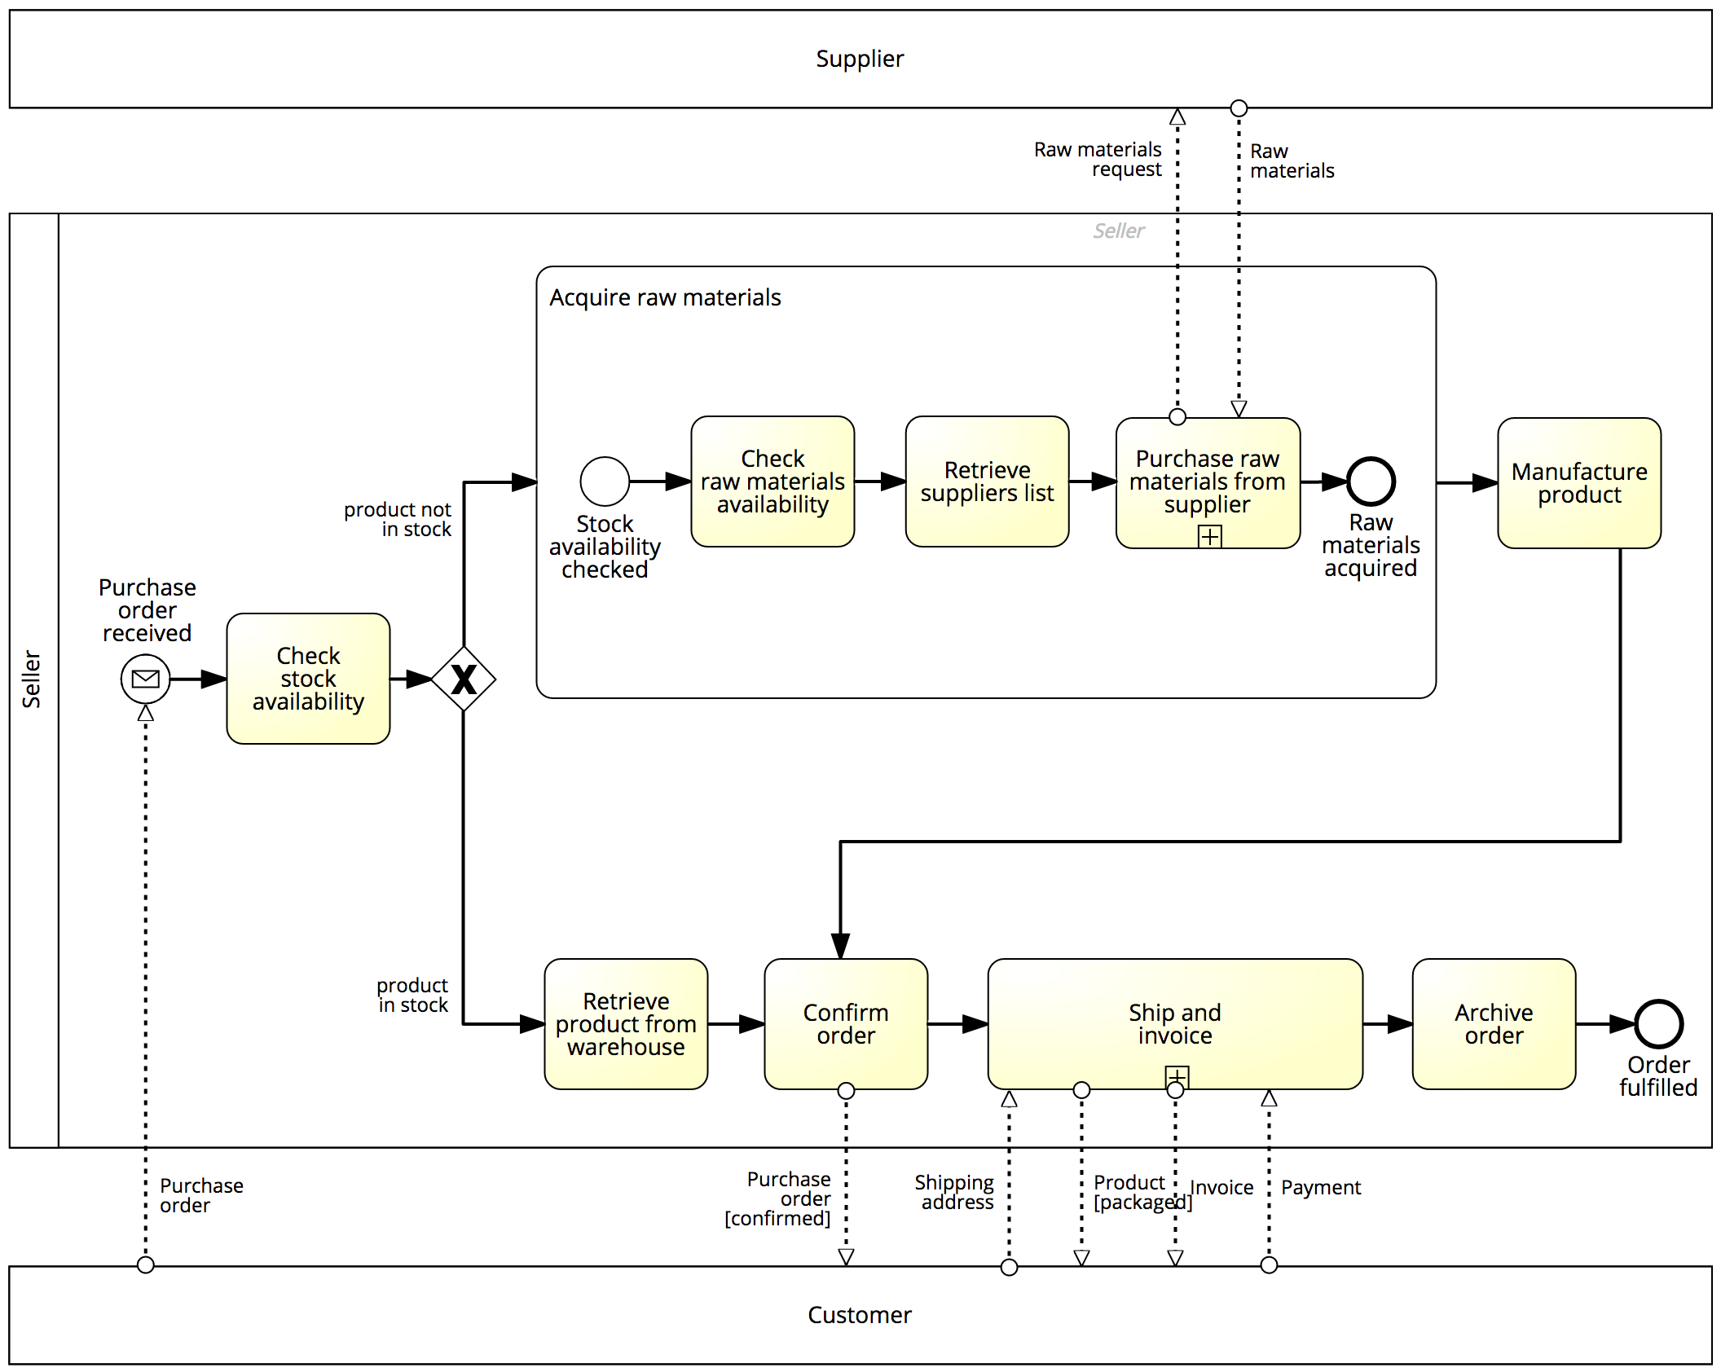
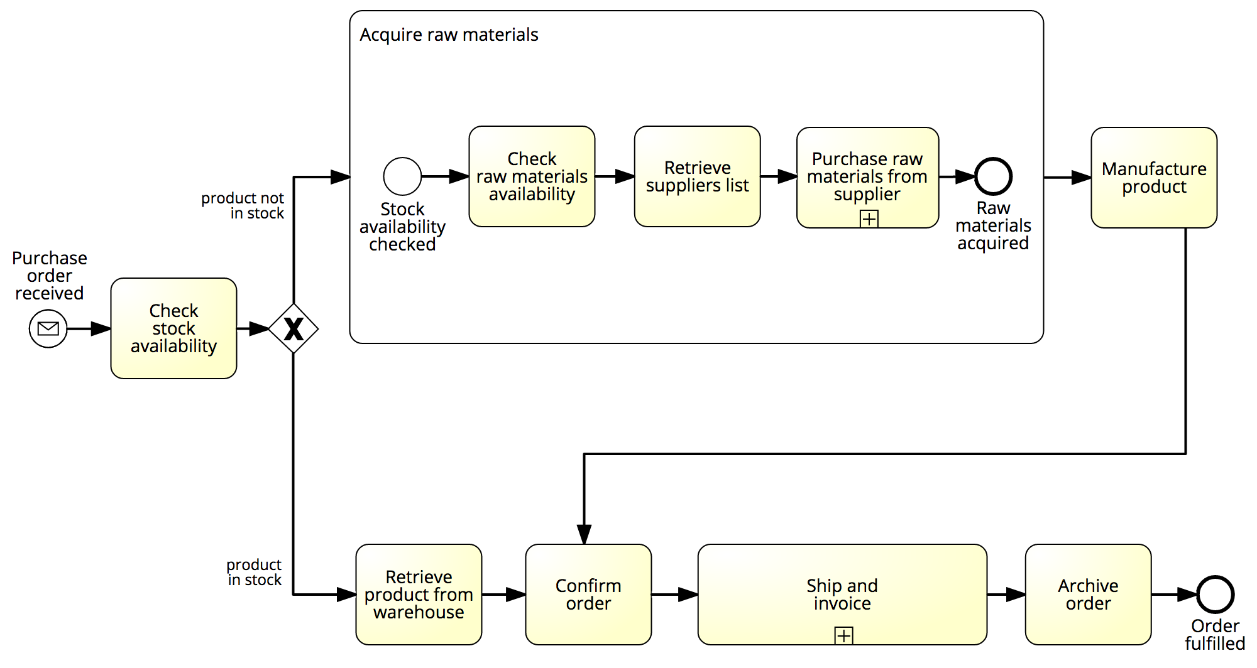
Our order-to-cash example… now with pools, messages and MI markers

Slide 26
Exercise
Model the following process fragment.
After a car accident, a statement is sought from two witnesses out of the five that were present in order to lodge the insurance claim. As soon as the first two statements are received, the claim can be lodged with the insurance company without waiting for the other statements

Slide 27
Uncontrolled Repetition: Ad-hoc sub-process
Contains activities to be executed in arbitrary order and number of times
May define order of sub-set of activities by sequence flow
Can be used in an early version of a process diagram when the order of execution is still unknown
Completion condition

Slide 28
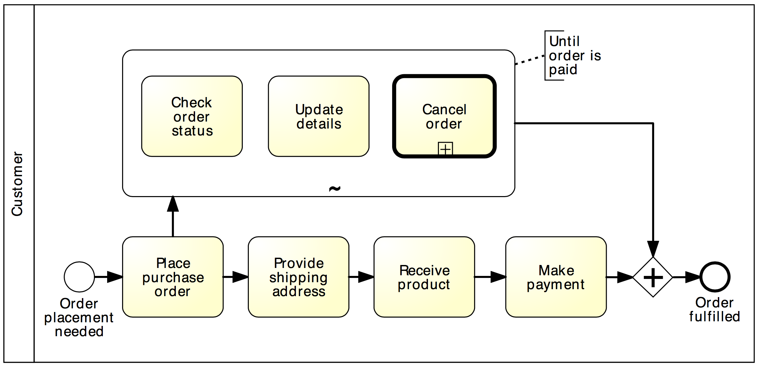
Example: Ad-hoc sub-process

Slide 29






Some BPMN Tools
https://en.wikipedia.org/wiki/Comparison_of_Business_Process_Model_and_Notation_modeling_tools
Notes:
Some are just modelling tools, while others allow you to simulate and execute processes.

Slide 30
Example using draw.io
https://www.youtube.com/watch?v=e9wANApZXL8&ab_channel=AngelotheBA
Notes:
https://www.youtube.com/watch?v=e9wANApZXL8&ab_channel=AngelotheBA

